Slide 1
The Google File System
Lecturer: Ngo Huy Bien
Software Engineering Department
Faculty of Information Technology
University of Science
Ho Chi Minh City, Vietnam
nhbien@fit.hcmus.edu.vn

Slide 2

Objectives
To explain how the Google file system works.

Slide 3

Contents
Google Needs.
Architecture.

Slide 4

References
Sanjay Ghemawat et al. (2003). The Google File System.

Slide 5
Paper Reading
Problems
Solution
Evaluation/Validation
Comparisons with prior work
Real world applications
Print the paper and prepare a highlighter.
Abstract: Terminology and background required.
Introduction: context, history and detailed requirements.

Slide 6
Terminology
File system
Scalable
Distributed
Draw a single-disk layout
Draw distributed disks.

Slide 7
Google Needs
Component failures are the norm. The file system consists of hundreds or even thousands of storage machines built from inexpensive commodity parts and is accessed by a comparable number of client machines.
Files are huge by traditional standards. Multi-GB files are common. Each file typically contains many application objects such as web documents.
Most files are mutated by appending new data rather than overwriting existing data. Random writes within a file are practically non-existent. Once written, the files are only read, and often only sequentially.

Slide 8
Google Specific Context
Co-designing the applications and the file system API benefits the overall system by increasing our flexibility.
We have relaxed GFS’s consistency model to vastly simplify the file system without imposing an onerous burden on the applications.

Slide 9
Result Overview
Multiple GFS clusters are currently deployed for different purposes.
The largest ones have over 1000 storage nodes, over 300 TB of disk storage, and are heavily accessed by hundreds of clients on distinct machines on a continuous basis.

Slide 10


Slide 11
Software Solution
Software Solution = Architecture + Data structures + Algorithms.

Slide 12
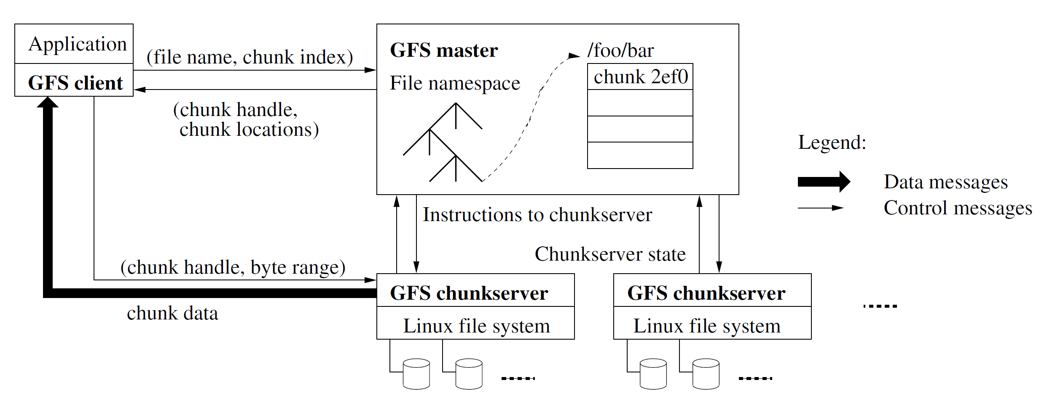
Architecture
A GFS cluster consists of a single master and multiple chunkservers and is accessed by multiple clients.
Files are organized hierarchically in directories and identified by pathnames.

Slide 13
Terms
File names.
Chunks.
Chunk handles.
Chunk servers.
Chunk data.
Draw a diagram showing the relationship among a file, its chunks, and the chunk servers.

Slide 14
Chunks and Chunkservers
Files are divided into fixed-size chunks.
Each chunk is identified by an immutable and globally unique 64 bit chunk handle assigned by the master at the time of chunk creation.
Chunkservers store chunks on local disks as Linux files and read or write chunk data specified by a chunk handle and byte range.
For reliability, each chunk is replicated on multiple chunkservers. By default, we store three replicas.

Slide 15
Chunk Size
We have chosen 64 MB, which is much larger than typical file system block sizes.
Each chunk replica is stored as a plain Linux file on a chunkserver and is extended only as needed.

Slide 16
Large Chunk Size Advantages
First, it reduces clients’ need to interact with the master because reads and writes on the same chunk require only one initial request to the master for chunk location information.
Second, since on a large chunk, a client is more likely to perform many operations on a given chunk, it can reduce network overhead by keeping a persistent TCP connection to the chunkserver over an extended period of time.
Third, it reduces the size of the metadata stored on the master. This allows us to keep the metadata in memory

Slide 17
Large Chunk Size Disadvantages
A small file consists of a small number of chunks, perhaps just one.
The chunkservers storing those chunks may become hot spots if many clients are accessing the same file.
Hot spots did develop when GFS was first used by a batch-queue system: an executable was written to GFS as a single-chunk file and then started on hundreds of machines at the same time.
We fixed this problem by storing such executables with a higher replication factor and by making the batch queue system stagger application start times.

Slide 18
The Master
The master maintains all file system metadata.
This includes the namespace, access control information, the mapping from files to chunks, and the current locations of chunks.
It also controls system-wide activities such as chunk lease management, garbage collection of orphaned chunks, and chunk migration between chunkservers.
The master periodically communicates with each chunkserver in HeartBeat messages to give it instructions and collect its state.

Slide 19
GFS Clients and Applications
GFS client code linked into each application implements the file system API and communicates with the master and chunkservers to read or write data on behalf of the application.
Clients interact with the master for metadata operations, but all data-bearing communication goes directly to the chunkservers.
Clients never read and write file data through the master. Instead, a client asks the master which chunkservers it should contact.
It caches this information for a limited time and interacts with the chunkservers directly for many subsequent operations.

Slide 20
API for Clients
We support the usual operations to create, delete, open, close, read, and write files.
GFS has snapshot and record append operations.
Snapshot creates a copy of a file or a directory tree at low cost.
Record append allows multiple clients to append data to the same file concurrently while guaranteeing the atomicity of each individual client’s append. It is useful for implementing multi-way merge results and producer-consumer queues that many clients can simultaneously append to without additional locking.

Slide 22
Metadata
The master stores three major types of metadata: the file and chunk namespaces, the mapping from files to chunks, and the locations of each chunk’s replicas.
All metadata is kept in the master’s memory.
The first two types (namespaces and file-to-chunk mapping) are also kept persistent by logging mutations to an operation log stored on the master’s local disk and replicated on remote machines.
Using a log allows us to update the master state simply, reliably, and without risking inconsistencies in the event of a master crash.

Slide 23
Memory-Only Approach Concern
One potential concern for this memory-only approach is that the number of chunks and hence the capacity of the whole system is limited by how much memory the master has.
If necessary to support even larger file systems, the cost of adding extra memory to the master is a small price to pay for the simplicity, reliability, performance, and flexibility we gain by storing the metadata in memory.

Slide 24
Chunk Location Information
The master does not store chunk location information persistently. Instead, it asks each chunkserver about its chunks at master startup and whenever a chunkserver joins the cluster.
A chunkserver has the final word over what chunks it does or does not have on its own disks.
There is no point in trying to maintain a consistent view of this information on the master because errors on a chunkserver may cause chunks to vanish spontaneously (e.g., a disk may go bad and be disabled) or an operator may rename a chunkserver.

Slide 25
Chunkserver Failures
Since a chunk can have multiple replicas, and updates are allowed, it is possible for some replicas to fall behind if a chunkserver fails or temporarily disconnects.
Without a mechanism to track which replica is the most recent, clients could read stale or inconsistent data.

Slide 26
Chunk Versions
Each chunk has a version number, assigned and incremented by the master when a new mutation (write/append) is committed.
This version is stored on the chunkserver along with the chunk data.

Slide 27
Roles of Chunk Versions
Consistency checks: Before applying a write, the master checks that all replicas are at the correct version. Any replica with an outdated version is considered stale.
Stale replica detection: If a replica has an old version, the master will either discard it or update it from a fresh replica to maintain uniformity.
Efficient replication: Only up-to-date replicas are used for serving reads and replicating data. This avoids propagating outdated data.

Slide 28
Operation Log
The operation log contains a historical record of critical metadata changes.
Files and chunks, as well as their versions are all uniquely and eternally identified by the logical times at which they were created.
We replicate it on multiple remote machines and respond to a client operation only after flushing the corresponding log record to disk both locally and remotely.
The master recovers its file system state by replaying the operation log.

Slide 29
Operation Log Checkpoint
To minimize startup time, we must keep the log small.
The master checkpoints its state whenever the log grows beyond a certain size so that it can recover by loading the latest checkpoint from local disk and replaying only the limited number of log records after that.
The checkpoint is in a compact B-tree like form that can be directly mapped into memory and used for namespace lookup without extra parsing.
It can be created in a minute or so for a cluster with a few million files. When completed, it is written to disk both locally and remotely.

Slide 30
Master Data Consistency
File namespace mutations (e.g., file creation) are atomic.
They are handled exclusively by the master: namespace locking guarantees atomicity and correctness.
The master’s operation log defines a global total order of these operations.

Slide 32
Mutation
A mutation is an operation that changes the contents or metadata of a chunk such as a write or an append operation.
Each mutation is performed at all the chunk’s replicas.

Slide 33
Leases
A lease has an initial timeout of 60 seconds.
However, as long as the chunk is being mutated, the primary can request and typically receive extensions from the master indefinitely.
These extension requests and grants are piggybacked on the HeartBeat messages regularly exchanged between the master and all chunkservers.
The master may sometimes try to revoke a lease before it expires (e.g., when the master wants to disable mutations on a file that is being renamed).
Even if the master loses communication with a primary, it can safely grant a new lease to another replica after the old lease expires.

Slide 34
Leases and Mutation Order
We use leases to maintain a consistent mutation order across replicas.
The master grants a chunk lease to one of the replicas, which we call the primary.
The primary picks a serial order for all mutations to the chunk.
All replicas follow this order when applying mutations.
Thus, the global mutation order is defined first by the lease grant order chosen by the master, and within a lease by the serial numbers assigned by the primary.

Slide 35
Mutation Order Example
Data preparation:
Write or append:
Replica 1 (Primary) | Replica 2 | Replica 3
Temporal data block #1 | Temporal data block #2 | Temporal data block #3
Temporal data block #2 | Temporal data block #1 | Temporal data block #1
Temporal data block #3 | Temporal data block #3 | Temporal data block #2
Replica 1 (Primary) | Replica 2 | Replica 3
W1. Temporal data block #1 | W1. Temporal data block #1 | W1. Temporal data block #1
W2. Temporal data block #2 | W2. Temporal data block #2 | W2. Temporal data block #2
W3. Temporal data block #3 | W3. Temporal data block #3 | W3. Temporal data block #3

Slide 36
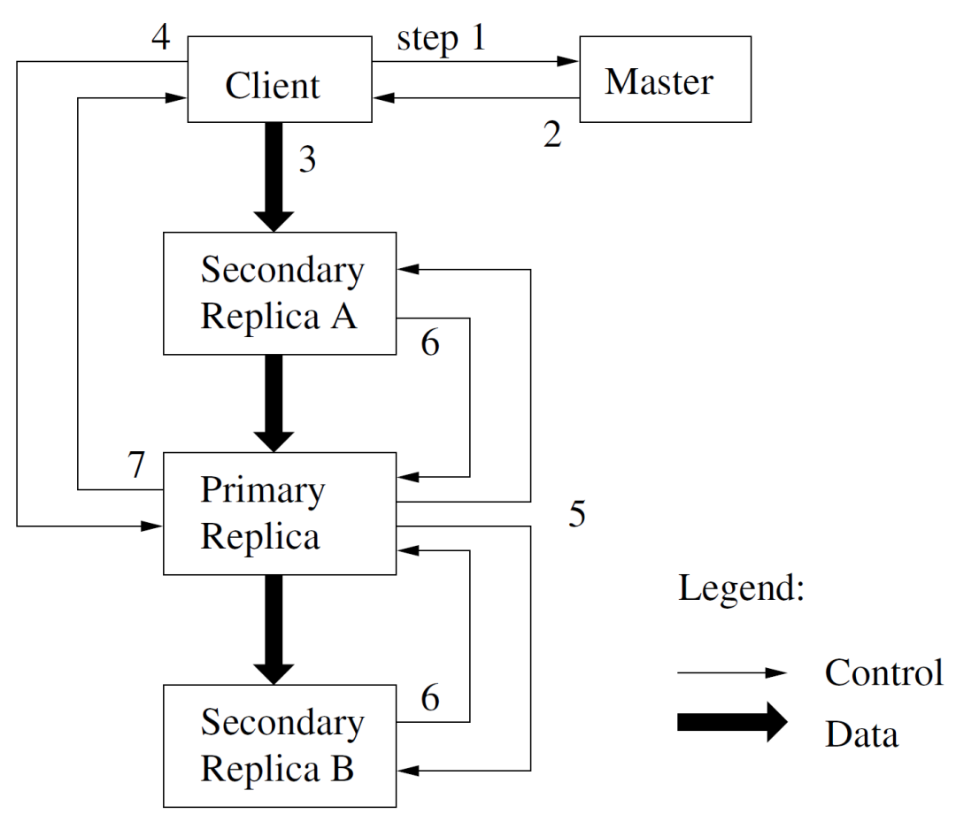
Write Control and Data Flow

Slide 37
Write Process: Step 1, 2 and 3
The client asks the master which chunkserver holds the current lease for the chunk and the locations of the other replicas. If no one has a lease, the master grants one to a replica it chooses.
The master replies with the identity of the primary and the locations of the other (secondary) replicas.
The client pushes the data to all the replicas. A client can do so in any order. Each chunkserver will store the data in an internal LRU buffer cache until the data is used or aged out.

Slide 38
Write Process: Step 4
Once all the replicas have acknowledged receiving the data, the client sends a write request to the primary.
The request identifies the data pushed earlier to all of the replicas.
The primary assigns consecutive serial numbers to all the mutations it receives, possibly from multiple clients, which provides the necessary serialization.
It applies the mutation to its own local state in serial number order.

Slide 39
Write Process: Step 5, 6 and 7
The primary forwards the write request to all secondary replicas. Each secondary replica applies mutations in the same serial number order assigned by the primary.
The secondaries all reply to the primary indicating that they have completed the operation.
The primary replies to the client. Any errors encountered at any of the replicas are reported to the client.

Slide 40
Errors Handling
In case of errors, the write may have succeeded at the primary and an arbitrary subset of the secondary replicas. (If it had failed at the primary, it would not have been assigned a serial number and forwarded.)
Our client code handles such errors by retrying the failed mutation.
It will make a few attempts at steps (3) through (7) before falling back to a retry from the beginning of the write.

Slide 41
Concurrent Writes
If a write by the application is large or straddles a chunk boundary, GFS client code breaks it down into multiple write operations.
They all follow the control flow described above but may be interleaved with and overwritten by concurrent operations from other clients.
Therefore, the shared file region may end up containing fragments from different clients, although the replicas will be identical because the individual operations are completed successfully in the same order on all replicas.

Slide 42
Interleaved Writes Example
Data preparation:
Write: C1 → W1a, W1b. C2 → W2.
Replica 1 (Primary) | Replica 2 | Replica 3
C1. Data block #1a | C2. Data block #2 | C1. Data block #1a
C2. Data block #2 | C1. Data block #1b | C1. Data block #1b
C1. Data block #1b | C1. Data block #1a | C2. Data block #2
Replica 1 (Primary) | Replica 2 | Replica 3
W1. Data block #1a | W1. Data block #1a | W1. Data block #1a
W2. Data block #2 | W2. Data block #2 | W2. Data block #2
W3. Data block #1b | W3. Data block #1b | W3. Data block #1b

Slide 43
Overwritten Writes
Data preparation:
Write: C1 → W1a, W1b. C2 → W2.
Replica 1 (Primary) | Replica 2 | Replica 3
C1. Data block #1a | C2. Data block #2 | C1. Data block #1a
C2. Data block #2 | C1. Data block #1b | C1. Data block #1b
C1. Data block #1b | C1. Data block #1a | C2. Data block #2
Replica 1 (Primary) | Replica 2 | Replica 3
W1. Data block #1a | W1. Data block #1a | W1. Data block #1a
W2. Data block #2 W3. Data block #1b | W2. Data block #2 W3. Data block #1b | W2. Data block #2 W3. Data block #1b

Slide 44
Atomic Record Appends
Concurrent writes to the same region are not serializable: the region may end up containing data fragments from multiple clients.
In a record append, however, the client specifies only the data.
GFS appends it to the file at least once atomically (i.e., as one continuous sequence of bytes) at an offset of GFS’s choosing and returns that offset to the client.

Slide 45
Atomic Record Appends Steps
The client pushes the data to all replicas of the last chunk of the file.
Then, it sends its request to the primary.
The primary checks to see if appending the record to the current chunk would cause the chunk to exceed the maximum size (64 MB).
If so, it pads the chunk to the maximum size, tells secondaries to do the same, and replies to the client indicating that the operation should be retried on the next chunk.
Record append is restricted to be at most one-fourth of the maximum chunk size to keep worstcase fragmentation at an acceptable level.
If the record fits within the maximum size, the primary appends the data to its replica, tells the secondaries to write the data at the exact offset where it has, and finally replies success to the client.

Slide 46
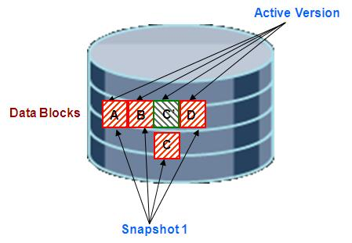
Copy vs. Snapshot
A snapshot only copies the settings and metadata.
Copy-on-write technique:

Slide 48
Simple Read
First, using the fixed chunk size, the client translates the file name and byte offset specified by the application into a chunk index within the file.
Then, it sends the master a request containing the file name and chunk index.
The master replies with the corresponding chunk handle and locations of the replicas. The client caches this information using the file name and chunk index as the key.
The client then sends a request to one of the replicas, most likely the closest one. The request specifies the chunk handle and a byte range within that chunk.

Slide 50
Read Lock vs. Write Lock
Read lock: Any other transaction (or multiple transactions) can read but not write. Lock shares with multiple transactions, i.e. shared lock.
Write lock: No other transaction can read or write. Lock does not share with any other transactions, i.e. exclusive lock.

Slide 51
Namespace Management and Locking
Unlike many traditional file systems, GFS does not have a per-directory data structure that lists all the files in that directory.
GFS logically represents its namespace as a lookup table mapping full pathnames to metadata.
Each node in the namespace tree (either an absolute file name or an absolute directory name) has an associated read-write lock.
Each master operation acquires a set of locks before it runs.
Typically, if it involves /d1/d2/.../dn/leaf, it will acquire read-locks on the directory names /d1, /d1/d2, ..., /d1/d2/.../dn, and either a read lock or a write lock on the full pathname /d1/d2/.../dn/leaf. Note that leaf may be a file or directory depending on the operation.

Slide 52
Chunk Replication
The master re-replicates a chunk as soon as the number of available replicas falls below a user-specified goal.
This could happen for various reasons: a chunkserver becomes unavailable, it reports that its replica may be corrupted, one of its disks is disabled because of errors, or the replication goal is increased.
The master picks the highest priority chunk and “clones” it by instructing some chunkserver to copy the chunk data directly from an existing valid replica.

Slide 54
File Region Consistency: Consistent
A file region is consistent if all clients will always see the same data, regardless of which replicas they read from.
Client 1 reads replica 1 and 2.
Client 2 reads replica 1 and 2.
Replica 1 | Replica 2
Data block 1 | Data block 1
Data block 2 | Data block 2
Data block 3 | Data block 3

Slide 55
File Region Consistency: Defined
A region is defined after a file data mutation if it is consistent and clients will see what the mutation writes in its entirety.
Client 1, 2 read replica 1 and 2.
Client 1 appends data block 4. Client 2 appends data block 5.
Replica 1 | Replica 2
Data block 1 | Data block 1
Data block 2 | Data block 2
Data block 3 | Data block 3
Data block 4 | Data block 4
Data block 5 | Data block 5

Slide 56
Consistent but Undefined
Concurrent successes: Client 1 writes data block 4. Client 2 overwrites data block 4 with data block 5. (Maybe Client 1 overwrites data block 5 with data block 4.)
Client 1, 2 read replica 1 and 2.
Replica 1 | Replica 2
Data block 1 | Data block 1
Data block 2 | Data block 2
Data block 3 | Data block 3
Data block 4 → 5 | Data block 4 → 5

Slide 57
Defined Interspersed with Inconsistent
Concurrent successes: Client 1 appends data block 4 = ¾ chunk size from the beginning of the chunk. Client 2 appends data block 5 = ½ chunk size.
Client 1, 2 read replica 1 and 2.
Replica 1 | Replica 2
Data block 1 | Data block 1
Data block 2 | Data block 2
Data block 3 | Data block 3
Data block 4 | Data block 4
Data block 5 | Data block 5

Slide 58
Inconsistent
Client 1 writes data block 4 successfully.
Client 2 writes data block 5 to replica 1 successfully, but the data block 5 could not written to replica 2 (server crash for example).
Client 1, 2 read replica 1 and 2.
Replica 1 | Replica 2
Data block 1 | Data block 1
Data block 2 | Data block 2
Data block 3 | Data block 3
Data block 4 | Data block 4
Data block 5

Slide 59
Writes or Record Appends
A write causes data to be written at an application-specified file offset.
A record append causes data (the “record”) to be appended atomically at least once even in the presence of concurrent mutations, but at an offset of GFS’s choosing.
In contrast, a “regular” append is merely a write at an offset that the client believes to be the current end of file.
The offset is returned to the client and marks the beginning of a defined region that contains the record.
GFS may insert padding or record duplicates in between. They occupy regions considered to be inconsistent.

Slide 60

Thank You & See You Again

